Slide 1
Machine Learning
Dr. Muhammad Adeel Nisar
Assistant Professor – Department of IT,
Faculty of Computing and Information Technology,
University of the Punjab, Lahore
Slides Courtesy: Dr. Andrew Ng

Slide 2

Unsupervised learning introduction
Clustering
Machine Learning

Slide 3


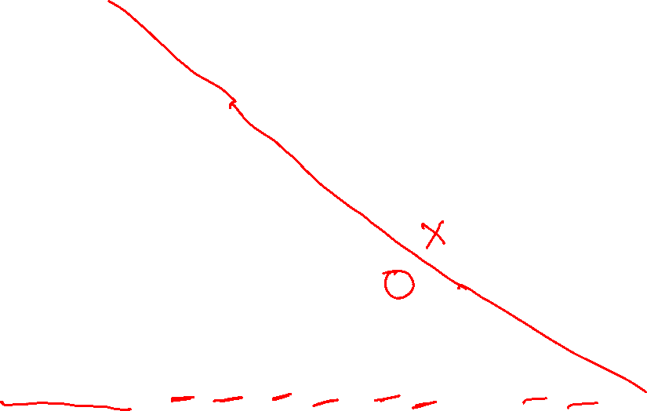
Supervised learning
Training set:

Slide 4
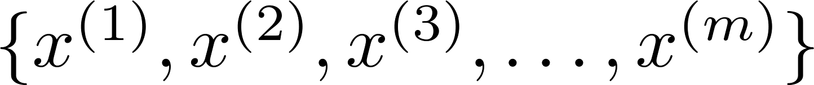
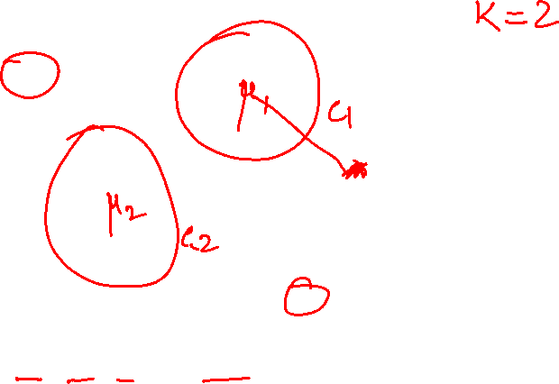
Unsupervised learning
Training set:

Slide 5


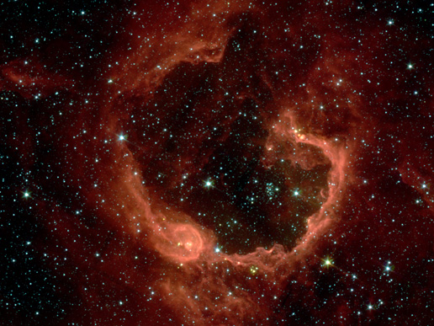
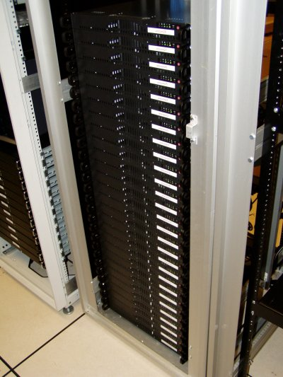
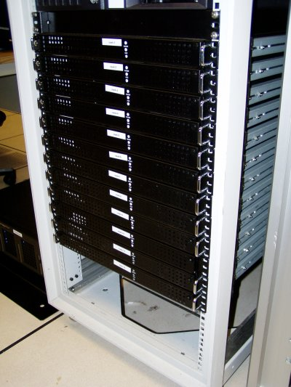
Applications of clustering
Market segmentation
Social network analysis
Image credit: NASA/JPL-Caltech/E. Churchwell (Univ. of Wisconsin, Madison)
Organize computing clusters
Astronomical data analysis
Notes:
Swap: market seg and organize clusters

Slide 6
K-means algorithm
Clustering
Machine Learning

Slide 7
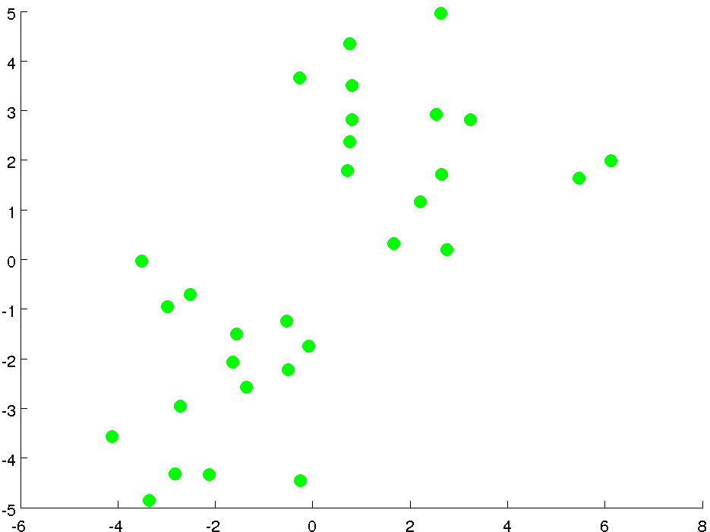


Slide 8
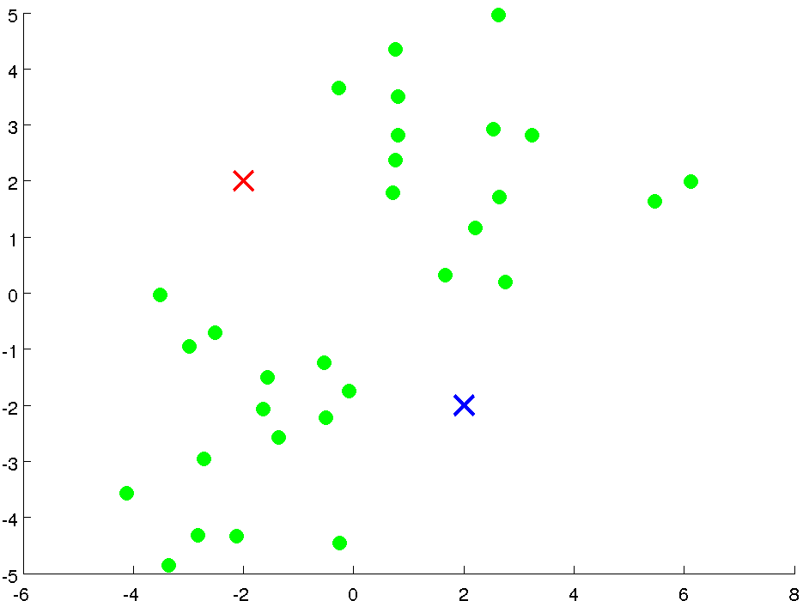

Slide 9
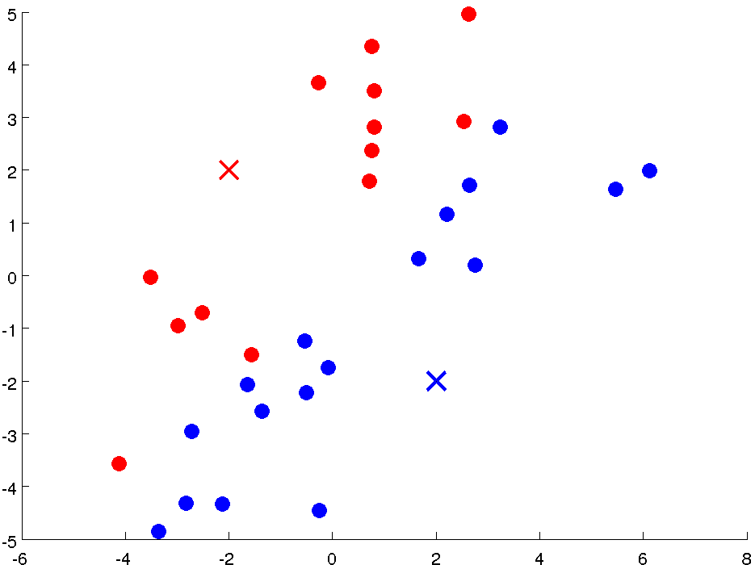
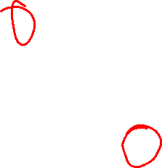

Slide 10
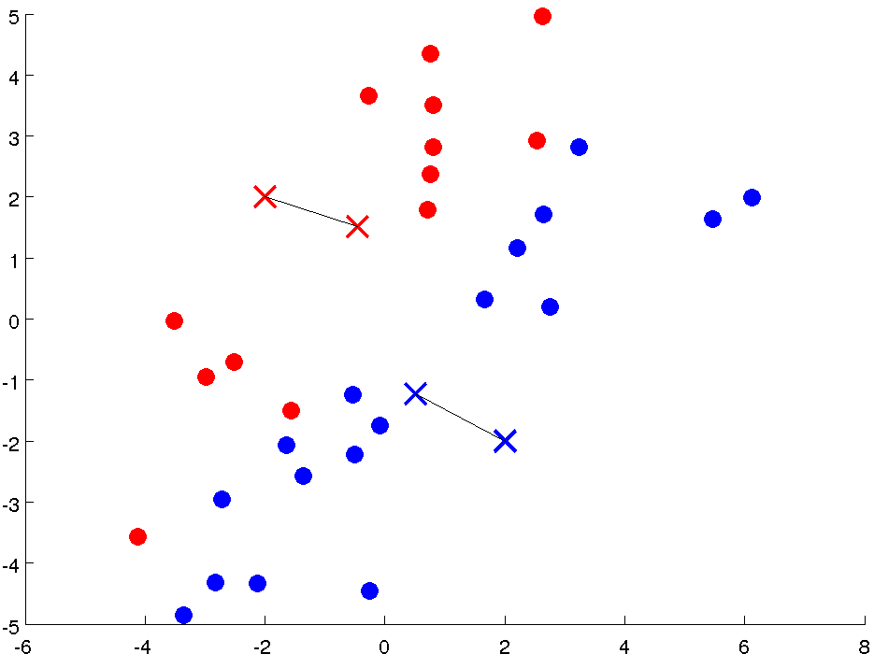

Slide 11
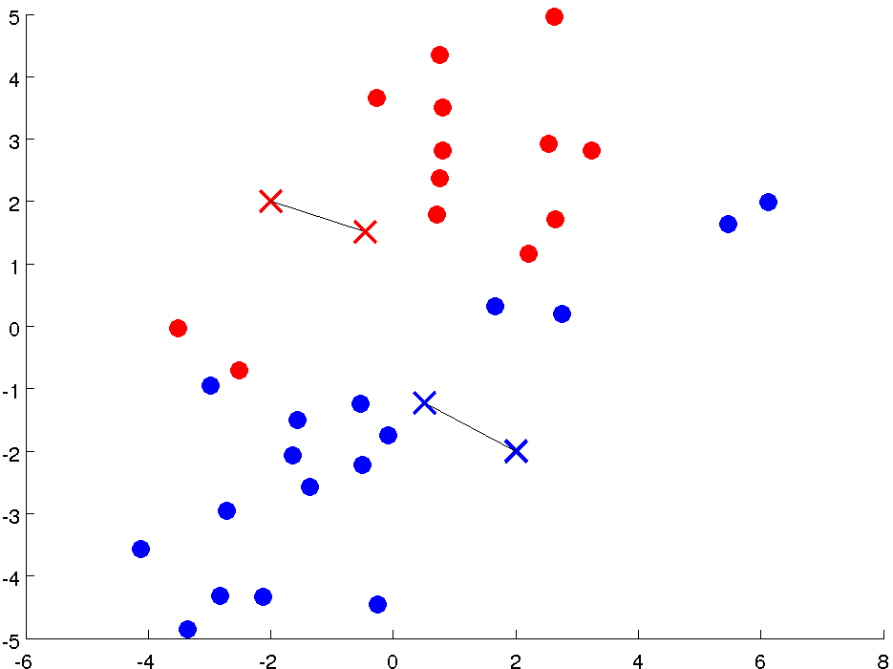

Slide 12
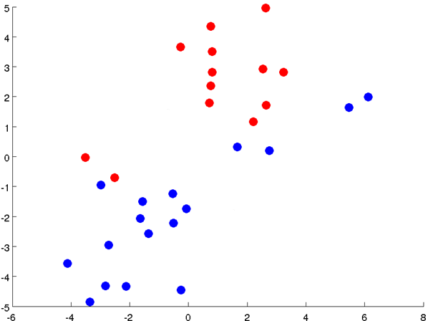

Slide 13
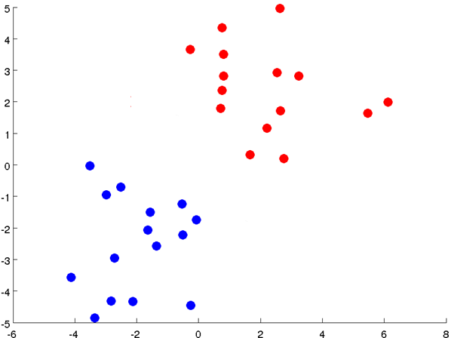
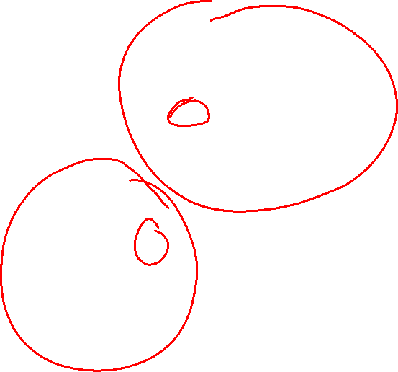

Slide 14
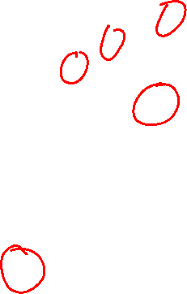
Notes:
Get rid of the legacy points

Slide 15
Notes:
Get rid of the legacy points

Slide 16

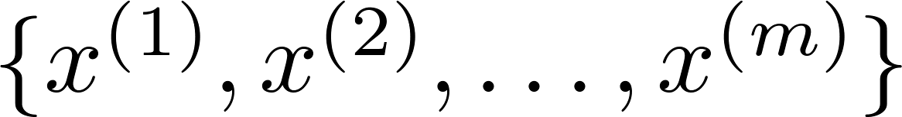
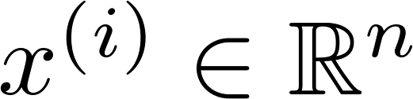
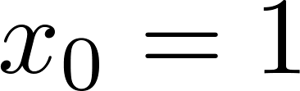

K-means algorithm
Input:
(number of clusters)
Training set
(drop convention)

Slide 17

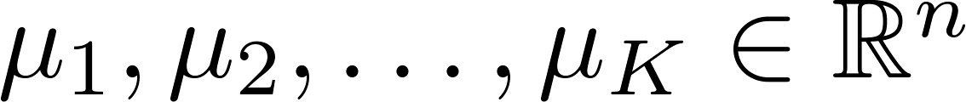
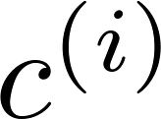
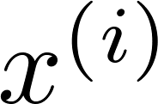

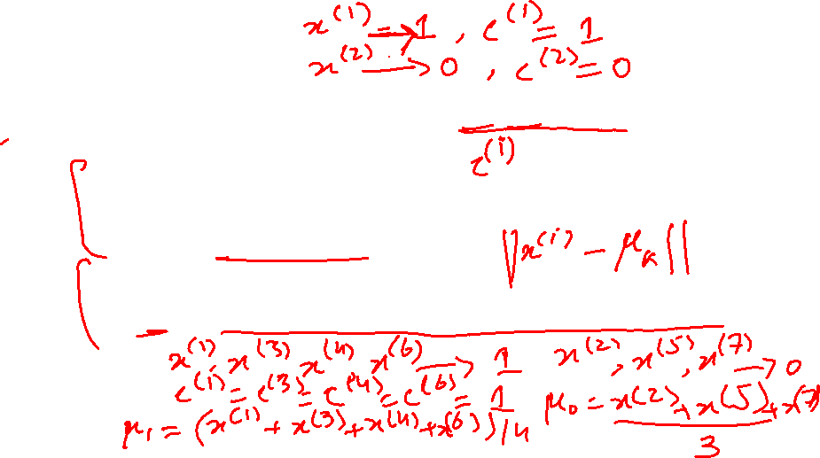
K-means algorithm
Randomly initialize cluster centroids
Repeat {
for = 1 to
:= index (from 1 to ) of cluster centroid
closest to
for = 1 to
:= average (mean) of points assigned to cluster
}
Notes:
Replace with normal text, size with LATEX fonts

Slide 18
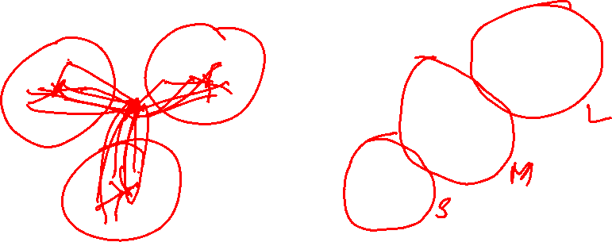
K-means for non-separated clusters
T-shirt sizing
Weight
Height

Slide 19
Optimization objective
Clustering
Machine Learning

Slide 20

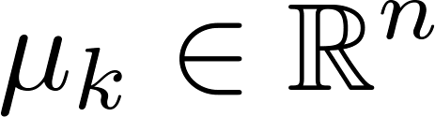

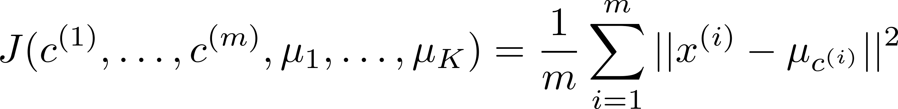
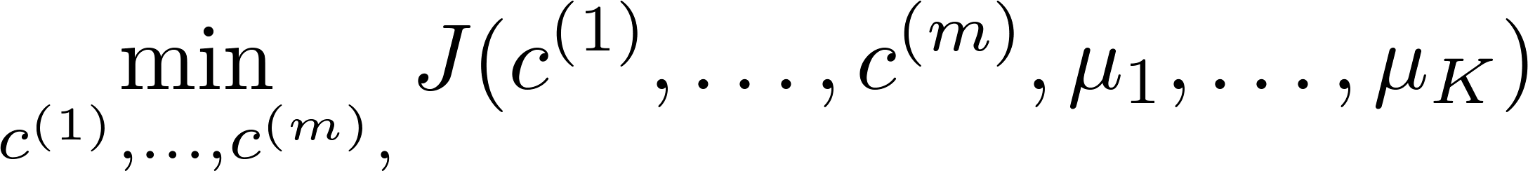

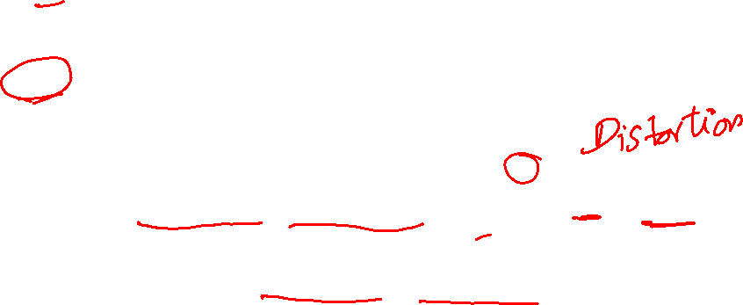
K-means optimization objective
= index of cluster (1,2,…, ) to which example is currently assigned
= cluster centroid ( )
= cluster centroid of cluster to which example has been assigned
Optimization objective:
Notes:
Change numbers to LATEX as well

Slide 21


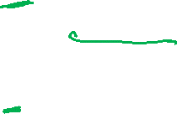
K-means algorithm
Randomly initialize cluster centroids
Repeat {
for = 1 to
:= index (from 1 to ) of cluster centroid
closest to
for = 1 to
:= average (mean) of points assigned to cluster
}
Notes:
Replace as previous; change spacing to fill page

Slide 22
Random initialization
Clustering
Machine Learning

Slide 23
K-means algorithm
Randomly initialize cluster centroids
Repeat {
for = 1 to
:= index (from 1 to ) of cluster centroid
closest to
for = 1 to
:= average (mean) of points assigned to cluster
}
Notes:
Replace as previous; change spacing to fill page

Slide 24

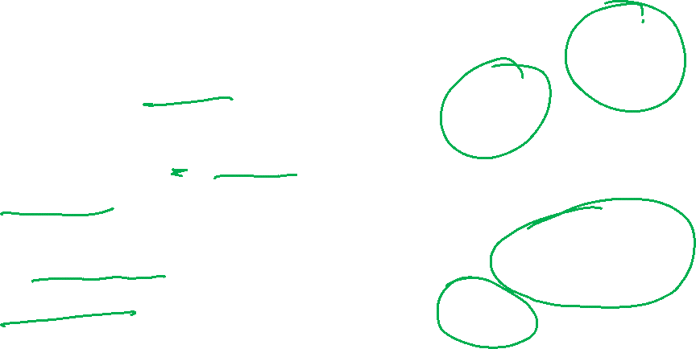
Random initialization
Should have
Randomly pick training
examples.
Set equal to these
examples.
Notes:
LATEX font

Slide 25
Local optima

Slide 26
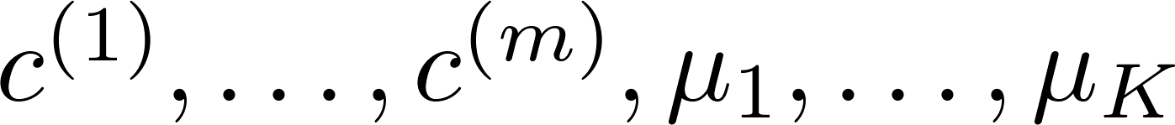
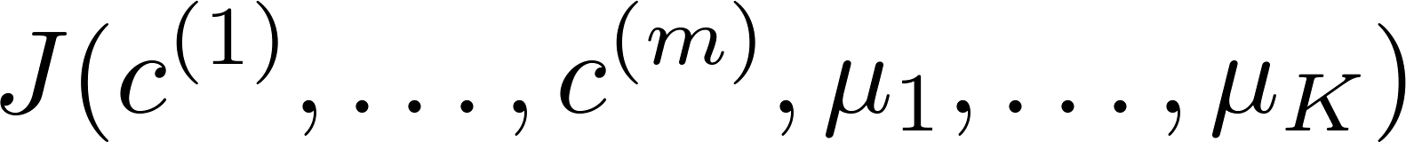
Random initialization
For i = 1 to 100 {
Randomly initialize K-means.
Run K-means. Get .
Compute cost function (distortion)
}
Pick clustering that gave lowest cost

Slide 27
Choosing the number of clusters
Clustering
Machine Learning

Slide 28
What is the right value of K?

Slide 29

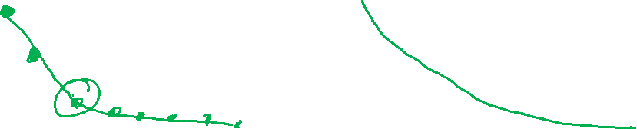
Choosing the value of K
Elbow method:
Cost function
Cost function
(no. of clusters)
(no. of clusters)

Slide 30
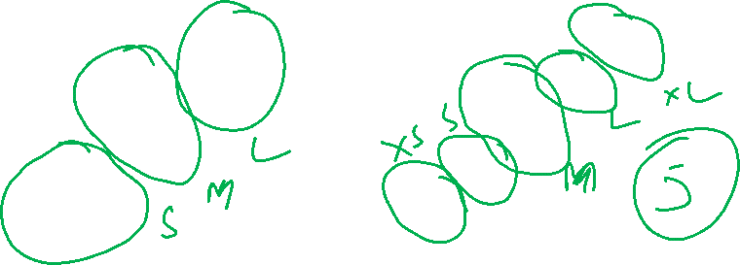
Choosing the value of K
Sometimes, you’re running K-means to get clusters to use for some later/downstream purpose. Evaluate K-means based on a metric for how well it performs for that later purpose.
E.g.
T-shirt sizing
T-shirt sizing
Weight
Weight
Height
Height

